Slide 1
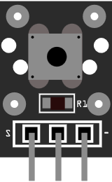
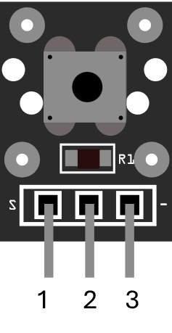
04 Push button
QC
R1
R1
S
-
1 2 3

